Slide 1

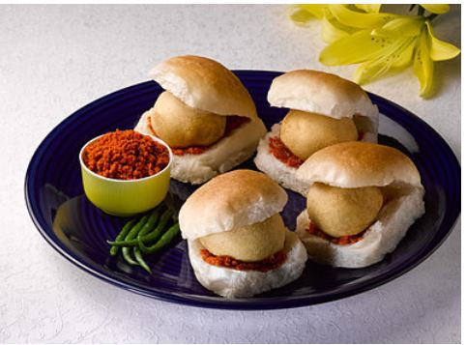
Strategy & New Innovation ABC Snacks Corner, Pune.

Slide 2
Agenda
Introduction
Problem Statement and Data Source
Objective and Methodology
Solution Description
Impact

Slide 3
Introduction Of ABC Snack Corner, Pune
Mr ABC wants to open a Wada Pav Shop near Shivaji Nagar in Pune.
He has got a location where there are other 4 more vadapav shop.
ABC has to think before investing anything for opening the shop.
He has to analyze and closely look at the other vadapav shops and their on-going daily activity.

Slide 4
Problem Statement & Data Source
As 4 more Vada-Pav shops will be near by from his shop, Mr ABC has started collecting the information form their customers manually, Social Media etc.
Information Content was :
Price,
Taste,
Hygiene,
Outlet information,
Communication
Raw Material Source
Data is collected and tabulated in Excel sheet with the rewords Points mentioned for easy comparison.

Slide 5
Objective & Methodology
Content | Shop-1 | Shop-2 | Shop-3 | Shop-4
Price, | 2 | 2 | 3 | 5
Taste, | 2 | 1 | 1 | 4
Hygiene, | 1 | 3 | 1 | 3
Outlet information, | 2 | 1 | 1 | 4
Communication | 5 | 4 | 4 | 1
Total | 12 | 11 | 10 | 17
ABC has carried out detailed analysis which will be useful to him to him to do a right investment at right content.

Slide 6
Solution Description
Analysing the Information Collected for few days
Understanding the trend of customer and their habbits
Preparation of self methodology in order to start his new shop

Slide 7
Business Impact
Content | ABC Snacks | Shop-1 | Shop-2 | Shop-3 | Shop-4
Price, | 4 | 2 | 2 | 3 | 5
Taste, | 5 | 2 | 1 | 1 | 4
Hygiene, | 4 | 1 | 3 | 1 | 3
Outlet information, | 4 | 2 | 1 | 1 | 4
Communication | 4 | 5 | 4 | 4 | 1
Total | 21 | 12 | 11 | 10 | 17
Created a proper analysis of customer’s expectation
Invested in various contents with proper strategy.

